Slide 1

MODULE 2: Accessibility Standards, Guidelines and Best Practices
Accessible Cultural Tourism Train-the-Trainer Program
Project: TACT - Training for Accessible Cultural Tourism
Funded by the European Union. Views and opinions expressed are however those of the author only and do not necessarily reflect those of the European Union or the Foundation Tempus. Neither the European Union nor Foundation Tempus can be held responsible for them.

Slide 2
Learning Objectives
By the end of Module 2, participants will be able to:
  Identify and explain the key international and European policies that drive accessibility in tourism and heritage contexts, including the UN Convention on the Rights of Persons with Disabilities and major EU directives or initiatives (e.g. European Accessibility Act, Web Accessibility Directive).
  List key accessibility guidelines and compare good practices in accessibility implementation across different tourism settings
  Understand how to interpret and apply standards and guidelines (such as accessibility standards ISO 21902: “Accessible Tourism for All”, national standards, or tourism accessibility certification criteria) in practical terms.
  Introduce the concept of accessibility auditing against standards, preparing participants for Module 3 by showing how standards and checklists form the basis of an audit.

Slide 3
Key International Policies
The United Nations Convention on the Rights of Persons with Disabilities
  Article 32 of the Convention explicitly calls for the objectives of the Convention to be promoted within the framework of international cooperation.
  The right to participation in tourism is explicitly enshrined in Article 30
European Disability Frameworks
  European Accessibility Act
  Strategy for the rights of persons with disabilities 2021-2030
  • AccessibleEU
The Web Accessibility Directive
National Laws and Building Codes
Sustainable Development Goals for Persons with Disabilities

Slide 4
Sustainable Development Goals for Persons with Disabilities
1. Ending poverty and hunger for all persons with disabilities (> SDGs 1+2) | 2. Ensuring healthy lives and promoting well-being for persons with disabilities (> SDG 3) | 3. Facilitating access to sexual and reproductive health care services and reproductive rights for persons with disabilities (> SDGs 3+5)
4. Ensuring inclusive and equitable quality education (> SDG 4) | 5. Achieving gender equality and empowering all women and girls with disabilities (> SDG 5) | 6. Ensuring availability of water and sanitation for persons with disabilities (> SDG 6)
7. Ensuring access to energy for persons with disabilities (> SDG 7) | 8. Promoting full and productive employment and decent work for persons with disabilities (> SDG 9) | 9. Increasing access to information and communications technology for persons with disabilities (> SDG 9)
10. Reducing inequality (>SDG 10) | 11. Making cities and human settlements inclusive and sustainable for persons with disabilities (> SDG 11) | 12. Building the resilience of persons with disabilities and reducing their exposure to and impact from climate-related hazards and other shocks and disasters (> SDG 1, 11+13)
13. Promoting peaceful and inclusive societies for sustainable development, providing access to justice for all and building effective, accountable and inclusive institutions (> SDG 16) | 14. Collect and provide data, in particular disaggregated by disability (> SDG 17)

Slide 5
Accessibility Guidelines and Standards in Tourism - Key Principles
Inclusion and equality. Tourism should be usable and enjoyable by people with different abilities, ages, and needs, without segregation or special treatment wherever possible.
Universal Design. Environments, services, and information should be designed from the outset to work for as many people as possible, rather than adapted later for specific groups.
Independence and dignity. Accessibility should support people to move, decide, and participate independently, with assistance offered respectfully when needed.
Information and transparency. Accurate, clear, and accessible information is essential. Many access barriers are created by uncertainty rather than physical obstacles.
Whole journey thinking. Accessibility is only effective when the full visitor journey is considered, from planning and booking through to arrival, experience, and departure.

Slide 6
Notable Accessibility Standards and Guidelines
Universal Design and Design for All
EN 17210:2021. Accessibility and usability of the built environment - Functional requirements
ISO Standards
  ISO 21542: Building construction – Accessibility and usability of the built environment.
  ISO 7001: Public information symbols.
  ISO 7010: Graphical symbols – Safety colours and safety signs.
  ISO 9241 series (Ergonomics of human-system interaction). ISO 17100 (Translation services).
Web Content Accessibility Guidelines (WCAG)
Other Technical Standards
Accessibility Checklists and Certification Criteria

Slide 7
ISO 21902:2021 – Accessible Tourism for All
Provides requirements and recommendations that can be applied by:
  Public authorities and destination managers
  Tourism businesses and service providers
  Cultural, natural, and heritage attractions
  Transport and mobility services
  Supporting services such as information centres and booking platforms

Slide 8
ISO Standard 21902 Relevancy
It provides the tools to:
  Avoid all kinds of access barriers for tourists and locals
  Ensure the integrity of the tourism value chain
  Raise awareness among the general public
  Train tourism officials and professionals
  Analyse the offerings of competitors and understand the market
  Gain knowledge on the benefits and business opportunities that accessible tourism entails
  Optimize customer service at tourist information centres and heritage sites
  Improve product design and marketing, as well as interpretation and presentation
  Deliver quality accessible experiences
  Design economic and fiscal incentives for companies to implement accessibility
  Save on costs for improvements in coordination by including accessibility in the planning

Slide 9
ISO 21902 - Areas of Action
I. ACCESSIBILITY ASSESSMENT
  Analysing the accessibility demand;
  Acquiring knowledge on the behaviour, specific access requirements, as well as the demographic and socio-economic characteristics of our audience;
  Providing information on accessibility of a particular cultural element.
II. AWARENESS RAISING AND TRAINING
  Ensuring that the decision-making personnel, cultural heritage managers and professionals, and support services staff, understand the widest possible array of accessibility requirements;
  Acquiring skills to provide assistance and support to visitors.

Slide 10
ISO 21902 - Areas of Action
III. REMOVAL OF BARRIERS
  Ensuring that the decision-making personnel, cultural heritage managers and professionals, and support services staff, understand the widest possible array of accessibility requirements;
  Acquiring skills to provide assistance and support to visitors.
IV. COMMONS SPACES
  Provision of spaces for common-use and routes that visitors need to transit or spend their time in, in order to be able to access and enjoy all the facilities which are meant for public use;
  Ensuring service excellence in common spaces for all audiences, with or without disability.

Slide 11
ISO 21902 - Areas of Action
V. HERITAGE SITES, MONUMENTS AND HISTORIC AREAS
  These elements are often the core of the cultural landscape of a destination and accessibility improves their operational features;
  A wide spectrum of accessibility solutions can be considered, while applying heritage conservation principles.
VI. MUSEUMS AND EXHIBIT SPACES
  Museums, galleries and exhibit venues attract major visitor flows of both locals and tourists;
  There is a wide range of solutions to making their buildings, services and content more accessible in order to create engaging experiences.

Slide 12
ISO 21902 - Areas of Action
VII. CULTURAL EVENTS AND STAGING ENVIRONMENTS
  Concerts, theatre, opera, dance performances, cinema and a wide range of cultural events can also be made accessible;
  The challenge is how to enhance accessibility of the physical environments (tangible aspects) and the specific programme content (intangible aspects).
VIII. DESIGNING CULTURAL TOURISM EXPERIENCES
  Provision of high quality, authentic, engaging and inclusive cultural tourism experiences for all, while observing the Universal Design principles;
  Partnering with cultural tourism specialists, guides and agencies to familiarize them with new accessible experiences.

Slide 13
ISO 21902 - Areas of Action
IX. INFORMATION, COMMUNICATION AND INTERPRETATION
  Development of channels and media platforms providing information about the accessibility features, target audiences and the content;
  Designing an innovative interpretative content in collaboration with end-users, other cultural institutions and professionals.
X. INSTITUTIONAL POLICIES
  Creation of a corporate or institutional vision and public commitment to enable access to culture for all people;
  Formalizing political support for a systemic action to improve accessibility; Developing a set of actions based on agreed objectives.

Slide 14
ISO 21902 - Areas of Action
XI. LABOUR INCLUSION
  Establishment of decent working conditions, economic independence, and self-realisation through employment in the cultural tourism ecosystem;
  Labour inclusion seen as a right and a profitable advantage, instead of a charitable action and legal obligation.

Slide 15
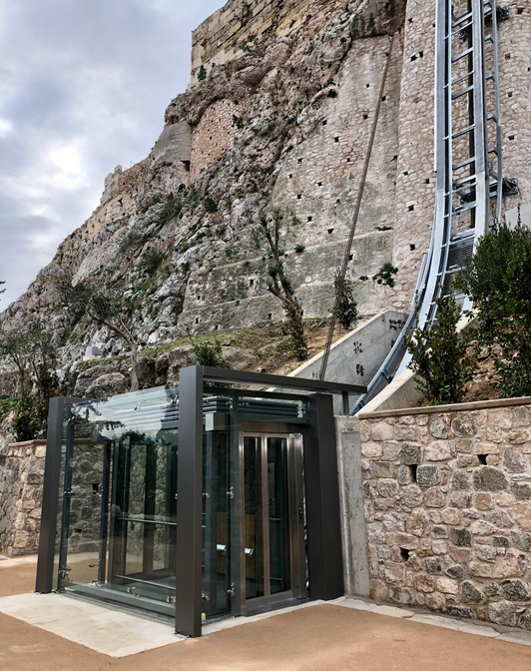
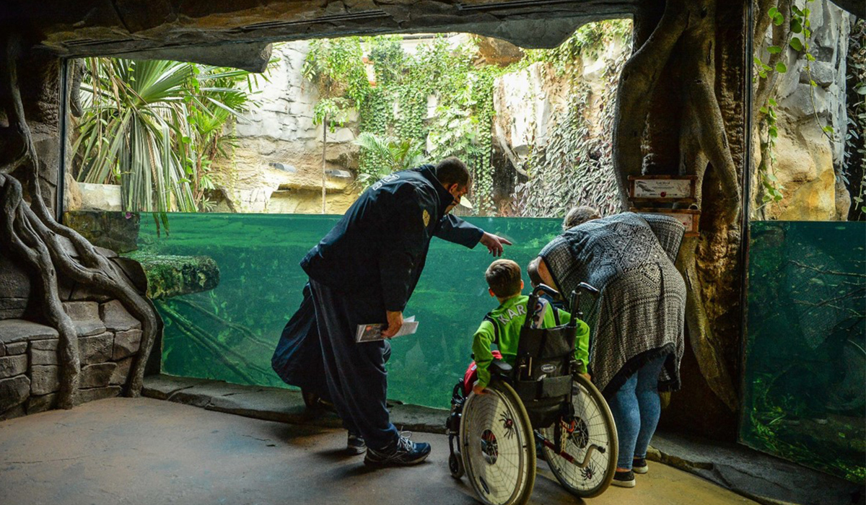
Real-World Examples
Acropolis, Athens
Chester Zoo

Slide 16
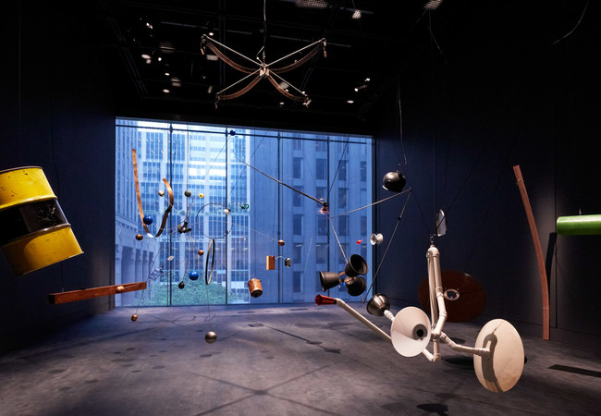
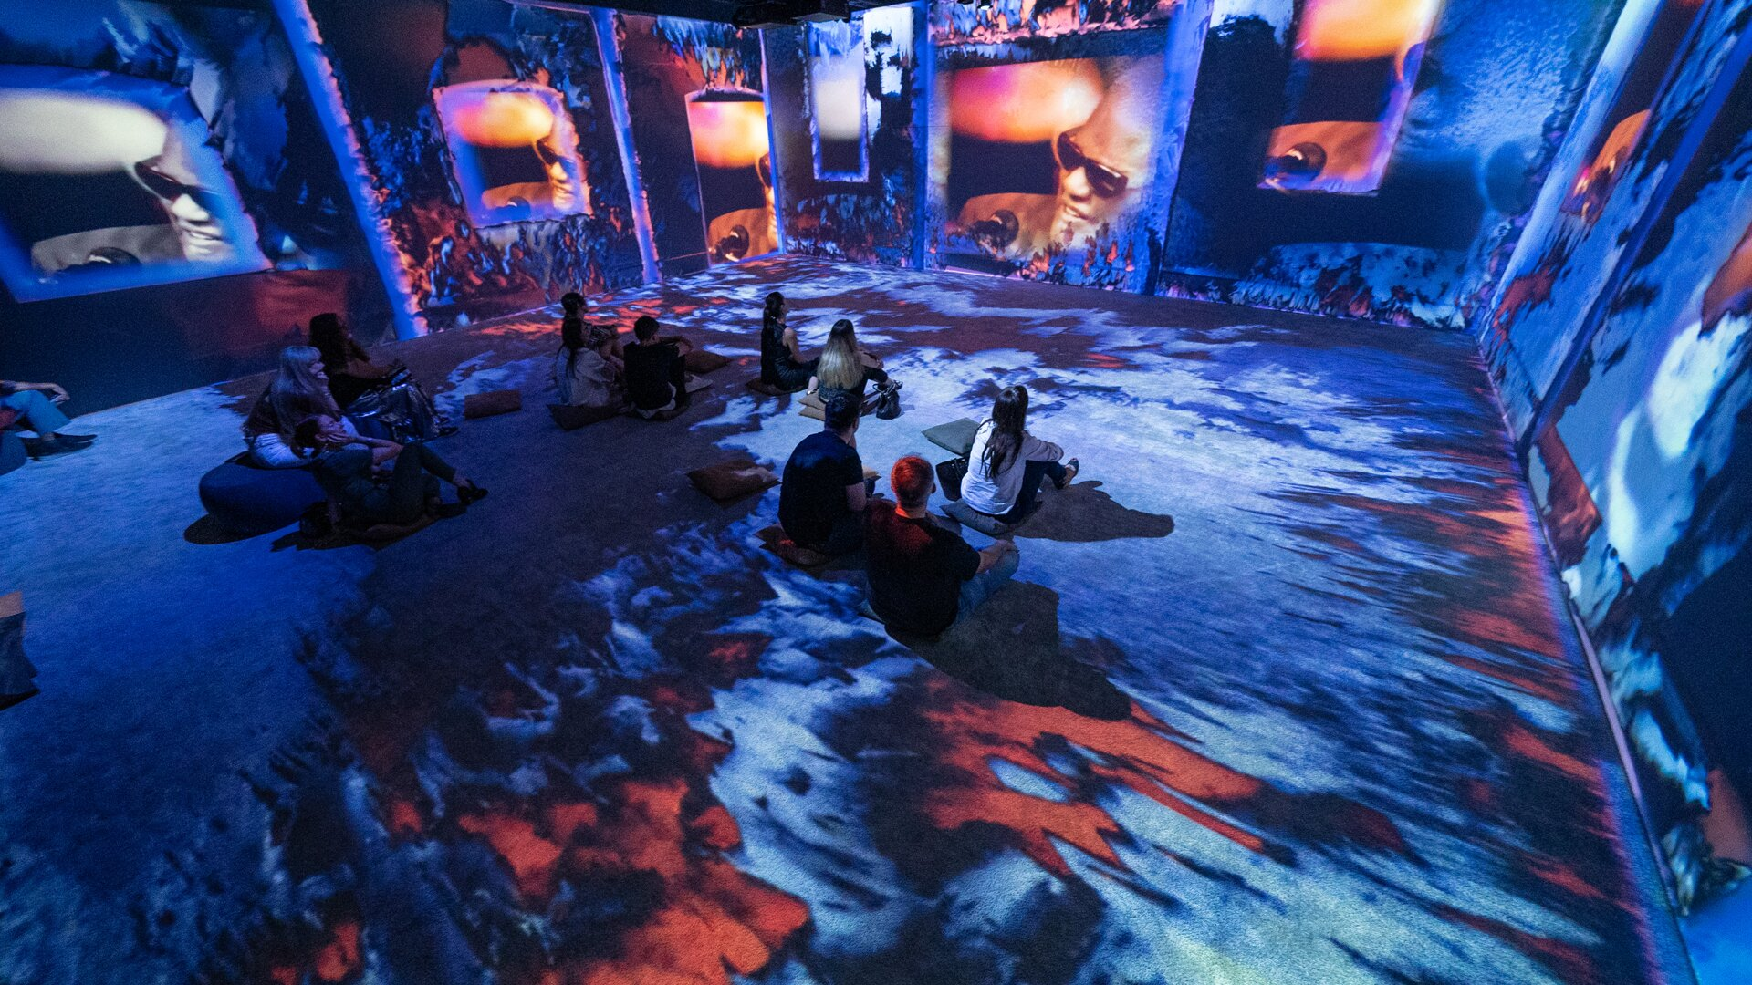
Real-World Examples
The Museum of Modern Art (MoMA) in New York
“Art with Disabilities” exhibition in Sofia

Slide 17
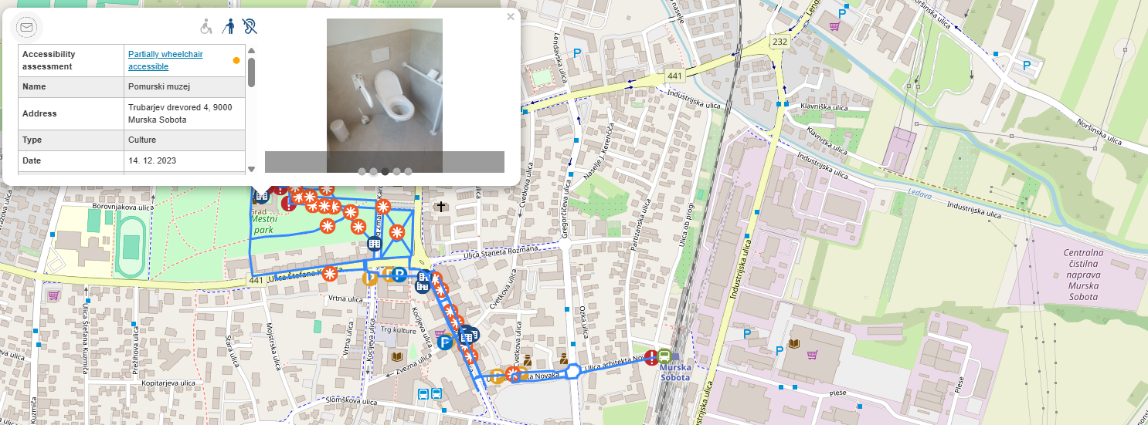
Real-World Examples
The Web Accessibility Viewer (WAV), Slovenia

Slide 18
Applying Standards in Practice – From Guidelines to Audits
When you conduct an accessibility audit of a site, you are essentially measuring the site against the criteria set out in standards or best practices
Practical Tip: Don’t worry about memorizing every number or rule.
Think about your own institution or a site you know. What accessibility standards or codes you believe your organisation has met and what could it be missing?

Slide 19
Key Takeaways
Tourism accessibility has a number of commitments and laws globally that define accessibility as an obligation/right.
The European Accessibility Act and the Web Accessibility Directive have established specific responsibilities for travel and cultural sectors regarding accessibility in terms of website accessibility, ticketing accessibility and transport accessibility.
The Universal Design philosophy provides both the theoretical framework and practical guidance for designing products/environments that can be used by everyone.
Specific accessibility standards (for example; ISO 21902 for Accessible Tourism) exist along with numerous guides/check lists that translate accessibility into tangible evaluation criteria.
Learn from best practice examples and case studies that provide a tangible illustration of how standards are being creatively applied in various contexts (museums, heritage sites, digital platforms).

Slide 20
THANK YOU!
Do you have any questions?
What was new or surprising for you?

